Slide 1
SPCPC Digital Innovation Community of Practice
Focus: AVT adoption
Lead / note
13:00
Welcome and introduction to the session
Dr Ragu Rajan, GP lead SPCPC Digital Innovation programme
13:05
Clinical safety: AVT focus
Dr Keith Grimes, Curistica / Digital Health & Governance Lead, SDHC
13:20
AVT implementation case study: Limetree Surgery, West Sussex
Tom Micklewright, Managing Partner, Limetree Surgery
13:30
AVT implementation case study: Foundry Healthcare, East Sussex
Kirstie Ingram (slides prepared by Jonathan Harris, DTL, Foundry)
13:45
AVT implementation case study: Community services pilot, SCFT
Antonia Frost, Chief Nursing Information Officer, SCFT
13:50
National AVT evaluation pilot: neighbourhood proposal
Ross Wickens, HIN KSS
13:55
Next steps: Upcoming webinar: triage models, what else?
Dr Ragu Rajan
Call to action: Please consider whether you can contribute a case study for the upcoming triage models webinar.

Slide 2
IMPLEMENTING HEIDI
How AVT has helped us

Slide 3

01
WHAT WE DID
  We implemented Heidi AVT back in April 2025.
  We ran a short, limited trial using the free version of Heidi first to assess impact.
  In April 2025 we decided to purchase the professional licence for all staff.

Slide 4

02
THE TECH BIT
  Heidi maintains NHS compliance by hosting data in the UK, encrypting it in transit (TLS 1.2+) and at rest (AES‑256), and aligning with DTAC, DCB0129 and NHS DSPT.
  Heidi is available to use in a web browser or as installed app.
  Direct integration with TPP Systm One, not currently available.
  SCW can add Heidi to Windows Software Centre for easy installation.

Slide 5
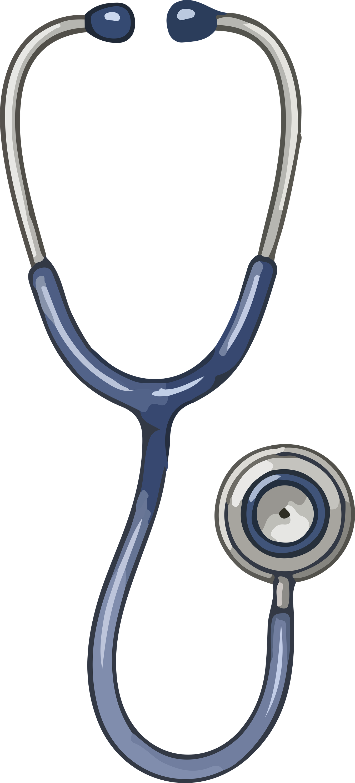
03
BENEFITS – WHAT DO OUR GPS SAY?
  Saving time by reducing the administrative burden.
  Time saved is primarily used to reduce overtime rather than increase volume of appointments.
  Increased focus on meaningful patient contact and complex clinical reasoning.
  Some improvement in the quality of the notetaking (though there is a caveat to this).
  Reduced cognitive load / end-of-day fatigue.

Slide 6
04
BENEFITS – NON-CLINICAL STAFF?
  Now regularly used by our management team for staff reviews, interviews, appraisals and other in person meetings.

Slide 7

05
DISADVANTAGES
  It doesn’t work for everyone – for some, note writing was too integral to their thinking/reasoning processes.
  There isn’t currently integration between Heidi and SystmOne – coding is not automatic – key to remind teams to code!
  Notes must be checked – AI hallucination is a real thing.
  Currently only works with phone consultations on speaker phone or where clinician repeats important patient information.
  Overreliance may reduce clinicians ability to summarise succinctly or formulate concise assessments over time.

Slide 8

06
KEY LESSONS ALONG THE WAY
  Asking consent – explicit in each consultation
Template on SystmOne for clinicians to record consent
(now replaced with internal Heidi process)
  You must review the notes before saving in the record for accuracy
Observations/diagnoses/etc must be read coded manually
  It doesn’t work for everyone
Some don’t like it
It doesn’t work in appointment that heavily utilise clinical templates

Slide 9
07
KEY LESSONS ALONG THE WAY (CONT.)
  It helps to develop a consultation template that matches your usual
note taking style.
  Remind people of the key learnings regularly along the way.

Slide 10

08
WHAT’S NEXT
  The Heidi task list!
  The roving ward mic.
  Clinical system integration…

Slide 11

Heidi AI AVT at Foundry Healthcare Lewes
At Foundry, Heidi AI is used as a workflow support tool: it creates a draft output that staff review before it enters the record or downstream process.
F2F and Telephone consultations
Foundry Heidi AI output templates
Clinician review
EPR entry
Consultation documentation
Referrals and secretarial workflow
Heidi supports note generation in face to face and telephone consultations. The output is structured using pre-defined Foundry Heidi AI templates, then reviewed and amended by the clinician before transfer into the EPR.
Referral letter drafting and related secretarial workflows have been built around Heidi. System protocols support standardised processing, with referral SOPs showing where Heidi fits into the local process.
Prepared by Foundry Healthcare for the Digital COP
Notes:
5-minute talk track:
Foundry is using Heidi AI AVT mainly for face-to-face and telephone consultations. We have also built referral letter and secretarial workflows around it. A key part of making it useful has been the use of pre-defined Foundry AI output templates, so the outputs are more consistent and easier to transfer into the EPR. For referral work, the protocols are system ones, but our SOPs describe where Heidi fits into the local referral process. The important message is that Heidi produces a draft and supports workflow; it does not replace clinical judgement or staff responsibility for the record.

Slide 12
How we embedded Heidi safely
We started small, learnt from real use, and used that learning to shape our Standard Operating Procedures, AI policies and training.
Governance baseline before pilot and wider rollout: Clinical Safety and Information Governance requirements, with initial AI usage guidance and SOPs developed to support safe use.
1
2
3
4
5
Small GP pilot
Issues and error log
Regular review
SOP and guidance
Training and rollout
Trialled by a small group of GPs first.
Captured problems, inaccuracies and learning points.
Reviewed themes to understand what was going well and what needed tightening.
Pilot learning shaped the AVT SOP and Foundry AI usage policy / guidance.
Staff training focuses on safe use, consent, review and practical examples.
What helped adoption
Safety habits built in
Learning loop
Heidi was simple and easy to use. Clinicians who would usually be cautious about change or technology engaged with it well once they saw the practical benefit.
Consent, immediate review and correction, and safe transfer into the EPR were embedded into the workflow rather than treated as optional extras.
The log gave us a ‘no blame’ way to spot recurring issues and improve the SOP and training from real practice examples.
Prepared by Foundry Healthcare for the Digital COP
Notes:
5-minute talk track:
We deliberately did not start with a big-bang rollout. Heidi was initially trialled by a small group of GPs. During that pilot we kept an issues and error log and reviewed it regularly. That was useful because it moved the conversation away from hypothetical AI risks and towards what was actually happening in consultations. The pilot helped shape the AVT SOP, Foundry's AI usage policy and guidance, and the training approach for wider staff. What helped adoption was how simple the tool was to use. Even some clinicians who are usually sceptical about technology took it on well because they could see the benefit quickly. The safety habits are consent, review and safe transfer into the EPR.

Slide 13
What worked, what got in the way, and our advice
What worked well
What got in the way
How we responded
• Easy for clinicians to pick up
• Improved patient interaction
• Less visible typing during consultations
• Clinicians reported a greater feeling of running to time
• Patients rarely declined consent
• Staff nervousness about AI
• Concern that AI could replace jobs
• Patient questions about transcription technology
• Need to build the habit of consent and immediate review
• Occasional output errors or missing information
• Clear SOPs and AI usage guidance
• Issues and error log
• Practical training using real examples
• Planned PLT webinar: AI overview, how it works, and using it safely
• Message: AI supports staff; it does not replace responsibility
Potential impact measures
clinician uptake
appointment completion time
error themes
patient feedback
referral processing
clinical admin within allocated time
Top tip
Start small, use real world errors to shape your SOP and training, and make consent plus review the non-negotiable safety steps.
Prepared by Foundry Healthcare for the Digital COP
Notes:
5-minute talk track:
The biggest positives were that Heidi was easy to use and quickly made sense to clinicians. It improved the feel of consultations because clinicians were not typing as much, and some described a greater feeling of running to time. It also supports more patient-friendly records and smoother downstream workflows, with a potential shift in middle-of-day clinical admin being completed during allocated admin time rather than outside it. The barriers were mostly about confidence and understanding: staff were understandably nervous about AI and whether it could replace roles, and patients sometimes asked about the technology behind transcription. Dissent from patients has been rare. Our response is to keep the governance visible but practical: SOPs, AI policy and guidance, a non-blame error log, and an upcoming PLT webinar covering what AI is, how it works, and how to use it safely. The advice to another practice is to start small, learn from real use, and build training around the things staff actually encounter.

