Slide 1
PCPC Webinar
Katherine Saunders, MD
29 October 2025

Slide 2
To cover today…
Our story so far
Our structure and link to ICTs
What we've done
What we’re being asked to do
What’s coming next
Questions, feedback and comments

Slide 3
Our journey so far
Led Proactive Care and Cohort ID Programme over winter
Commenced QI Programme
Leading Highest and Ongoing Need Programme.
April 2024
Sept 2024
Jan - Feb
2025
Apr - May
2025
Jun – Aug
2025
Present
Started in shadow form, established structure including neighbourhood leads
Recruited to GP & CP lead roles
Chair recruited and TOR signed off
PMA elected PM Reps joined
Finalised MOU with ICB
Ask for Delivery arm to support ICB changes and need to work in neighbourhood alliance
Ready to form Sussex Integrated Health as Delivery Arm.
In Neighbourhood Alliance.
ICT leaderships groups established.
Dentists and Opticians join from end October

Slide 4
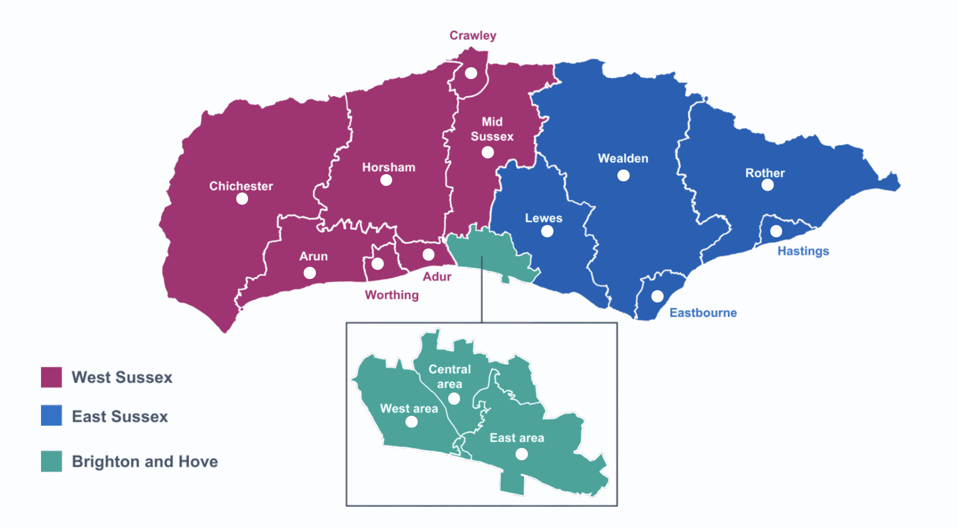
Leading ICT Development
For each ICT Leadership Group:
Named GP Lead
Named Management Support
Named Community Pharmacist
Initial Focus
Bringing Practices together
Bringing Pharmacies together
Bringing the two together
Joining (and in some cases leading) ICT Leadership Groups
Linking to community panels
sussexpcpc.org/about/our-neighbourhoods

Slide 5
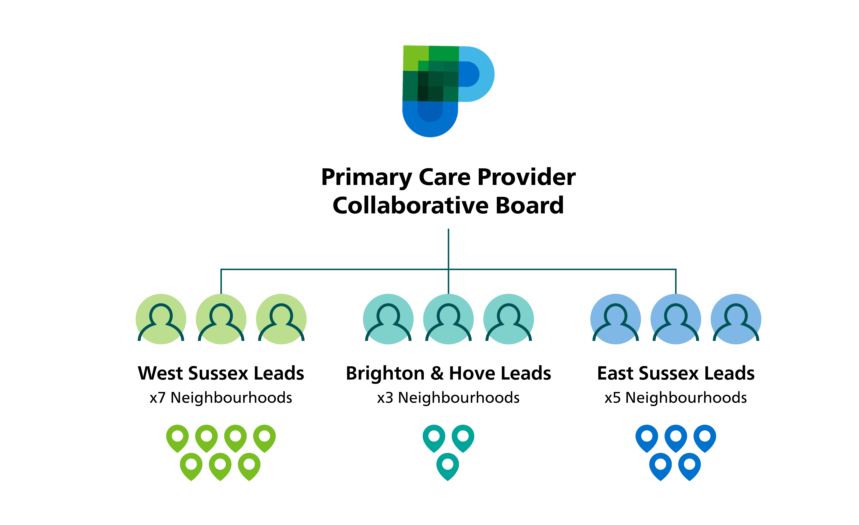
Our Structure
Independent Chair
Local Committee Representatives
Place leads for GP, GP Management and CP
Managing Director
Delivery Arm link
Our Neighbourhood Leads are key to PCPC’s vision
sussexpcpc.org/about/ourboard
Notes:
Emphasise local committees as key part of board and the direct link to ICT leadership

Slide 6
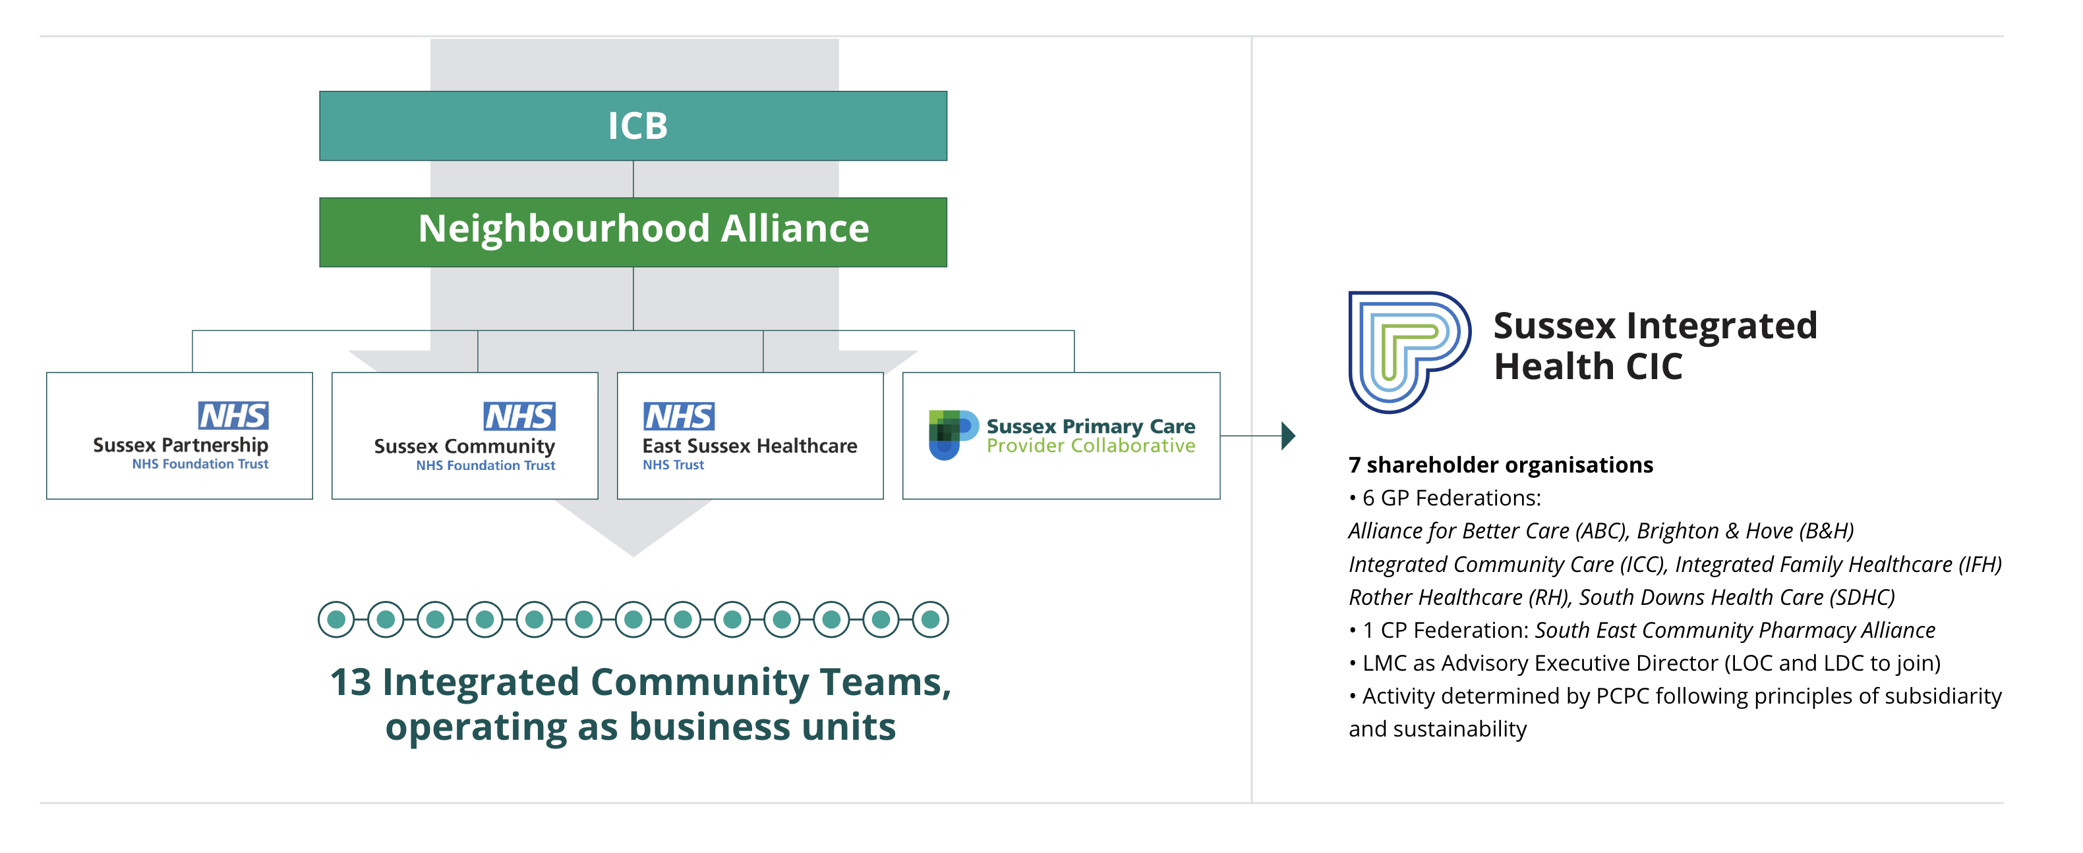
Being able to deliver
About Sussex Integrated Health CIC | Sussex Primary Care Provider Collaborative

Slide 7
What we're being asked to do next – Commissioning Intentions
Development of PCPC
Build on progress so far, strengthen relationships, ensure 2 way communication
Working with Partners
Increase usage of Advice and Guidance
Work with acutes on same day access and overall access
Primary / Acute interface development across providers
Resilience and Support
Develop a resilience programme for practices including supporting practice management, CQC and quality improvement across key clinical outcomes
Support Neighbourhood Development
Developing a leadership support programme for neighbourhood leads
Have consistent JD for GP Neighbourhood leads
Promote and support use of risk stratification and shared cared record
Develop structure and governance to support primary care delivery
With Neighbourhood Alliance – impact on emergency avoidable admissions, targeted improvements in each ICT and support to innovation
Increased uptake of SMI health checks

Slide 8
What’s coming next….
Discussions with ICB on resource to support delivery of Commissioning Intentions at PCPC and ICT level
Formation of Neighbourhood Alliance Board
Sussex Integrated Health CIC Established
New areas of work – T2 Diabetes in the Young, ADHD Pathway, Community Diagnostic Centre
Development and sharing of work plan for 26/27
Oct 25
Dec 25
April 26
June 26
March 27
Respond to CI
Submit workplan
Signed MOU and specification
Leadership support programme starts
Workplan delivery
Impact on elective and emergency performance

Slide 9



Keeping in touch….
Visit our new website
sussexpcpc.org
Join our next webinar
Wednesday 28th January 2026 12:30-13:30
News and Events | Sussex Primary Care Provider Collaborative
Sign up to our newsletter
PCPC newsletter

